Slide 1
APEC Lesson Study Projects in Mathematics, Science and Emergency Preparedness Education
Proposed by Thailand and Japan since 2006
The Projects for the Priority Area by Educational Ministerial Meeting (2004, 2008, 2012)
The Projects for the Darwin Declaration of APEC Energy Ministers (2007)
Reporter
Maitree Inprasitha,PhD,
Masami Isoda, PhD.
Project Overseers
APEC Lesson Study Project
The Projects are acknowledged by the Educational Ministers at Gyeongju (2012)

Slide 2
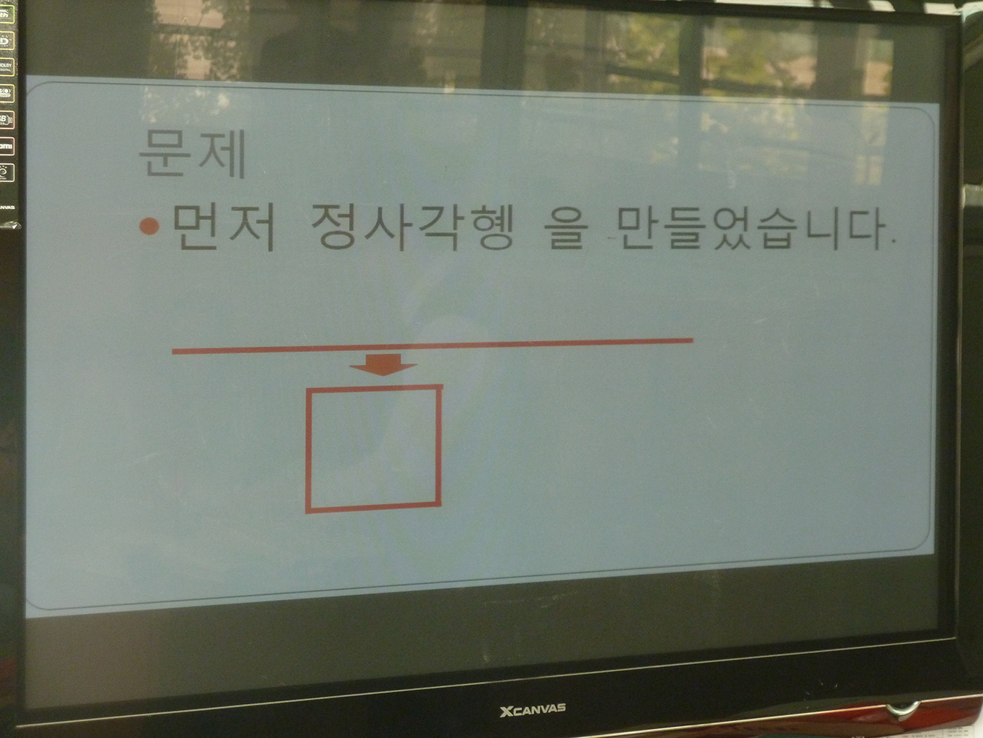
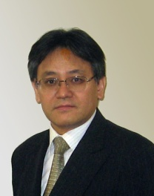
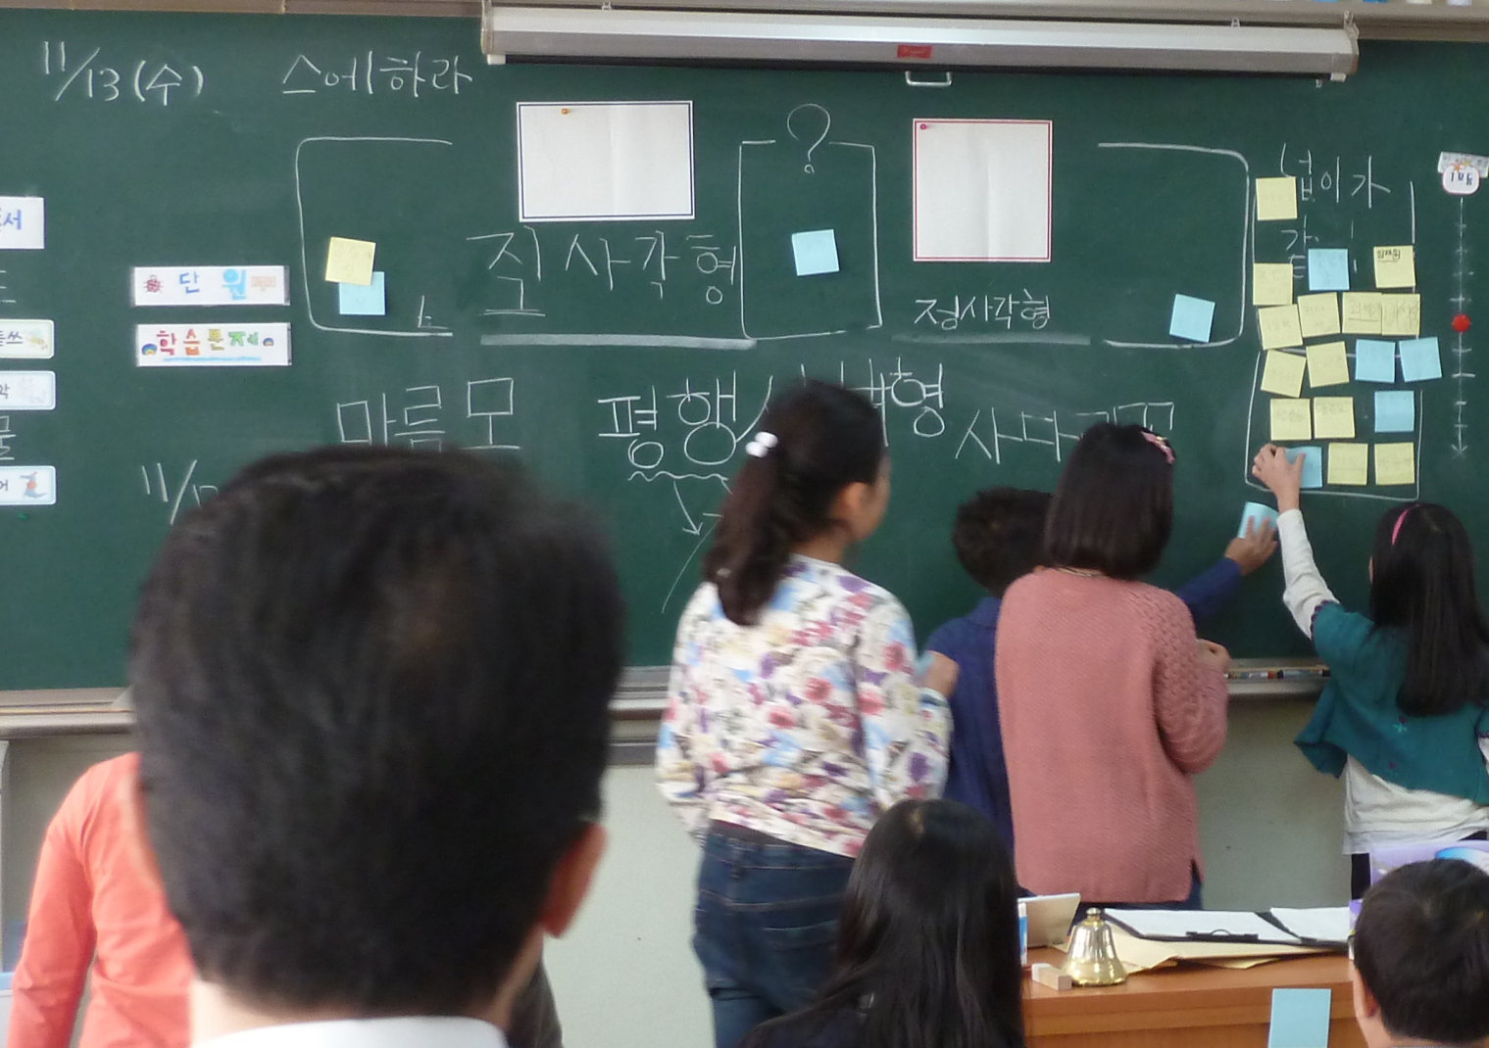
Seoyi Elementary School
감사합니다
Mathematics is Universal Subject for 21st C. Literacy on Knowledge Based Society!
The misconception also shared in economies!!
Phenomena!

Slide 3
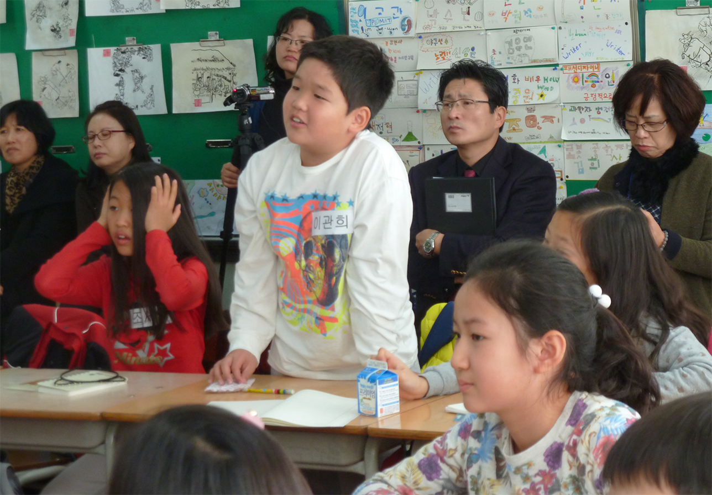
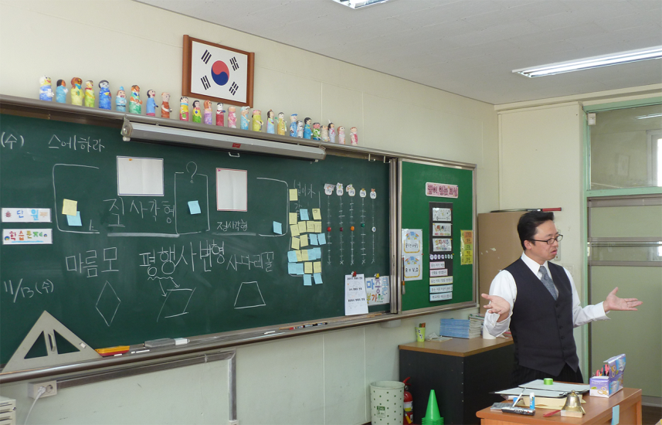
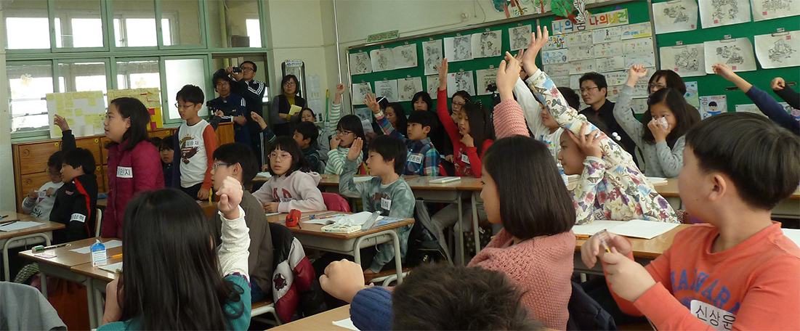
What is lesson study?
1) Plan, Do, Discussion-Reflection (Check and Act ) cycle for improvement
2) Theorization of PCK as for the theory for math-education
3) Reproductive science for better practice
Established T
⇔ Practical T.
Participating Teachers
Lesson
Study
(Theme)
Teacher
Children
Subject Matter
Various phenomena as for the better practice and examples for designing practical theory

Slide 4
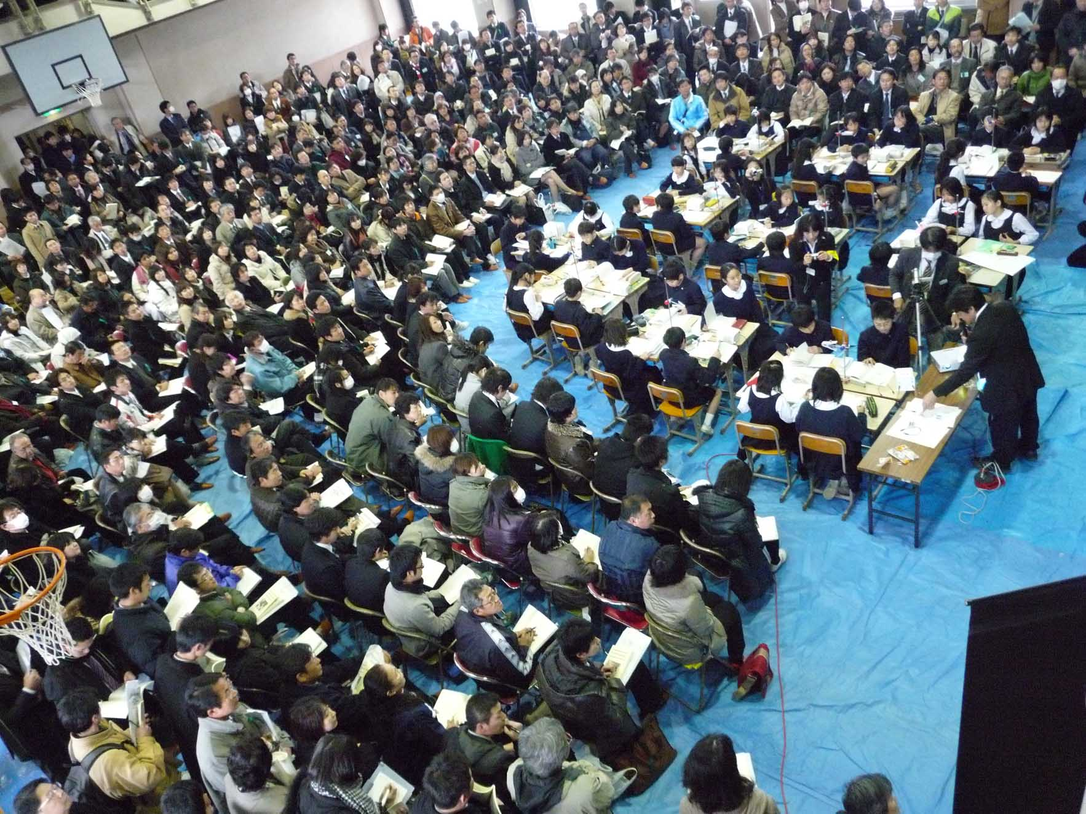
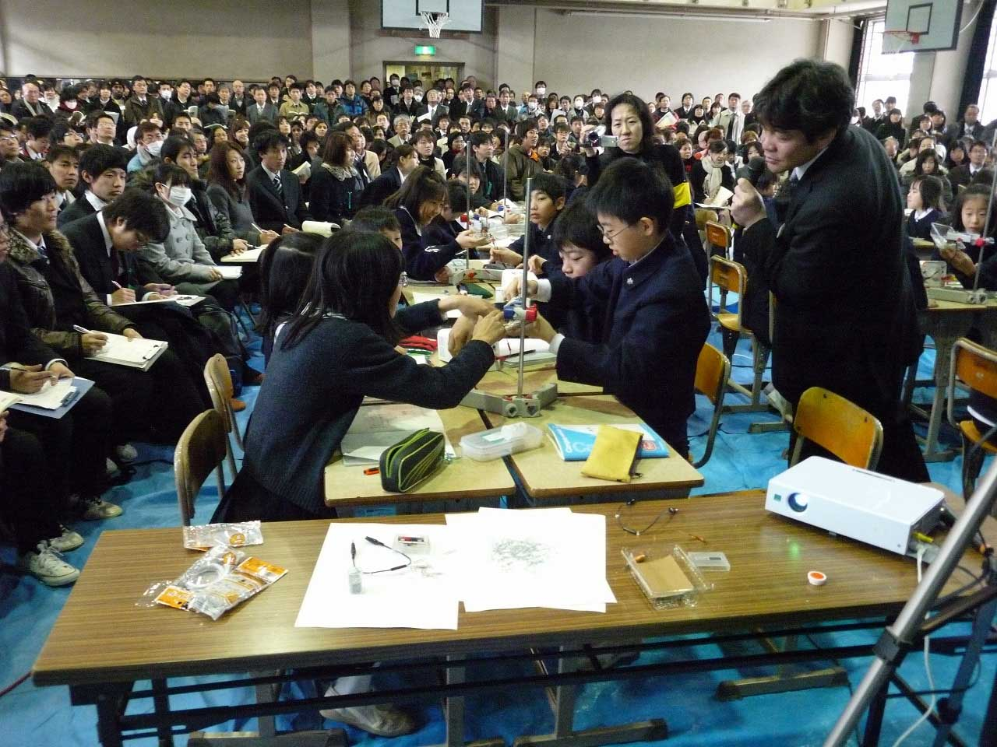
1. Overview:
What is lesson study?
Through LS, teachers enable to enjoy their life as teachers for themselves.
LS is the bottom up style innovation in Education from teachers.
1) Plan, Do, Discussion-Reflection (Check and Act ) cycle for improvement
2) Theorization of PCK as for the theory for math-education
3) Reproductive science for better practice
Curriculum Theory
Practical Theory
Participating Teachers
Lesson
Study
(Theme)
Teacher
Children
Subject Matter
Various phenomena as for the better practice and examples for designing practical theory

Slide 5
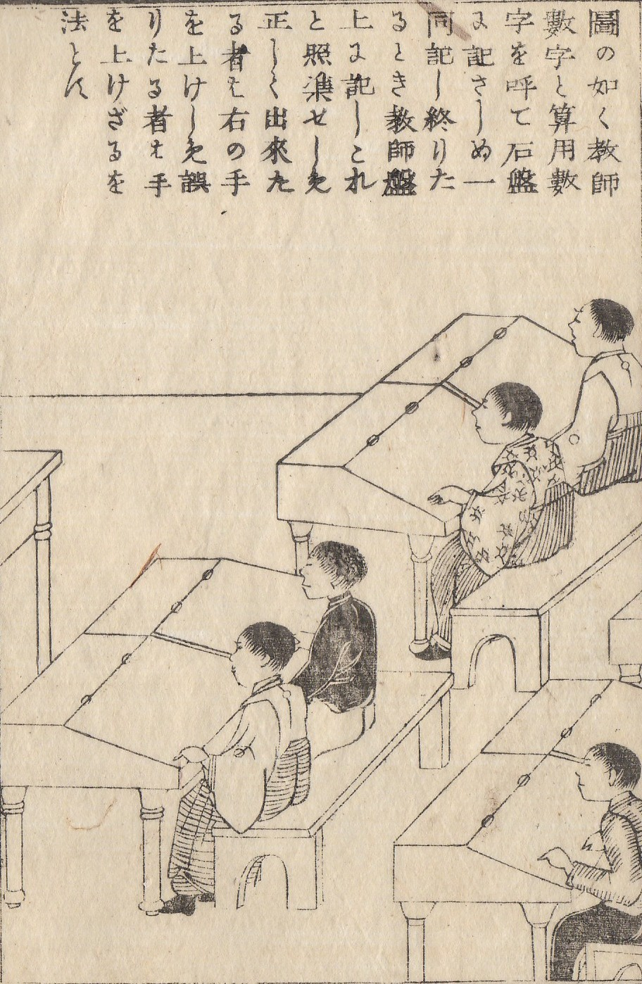
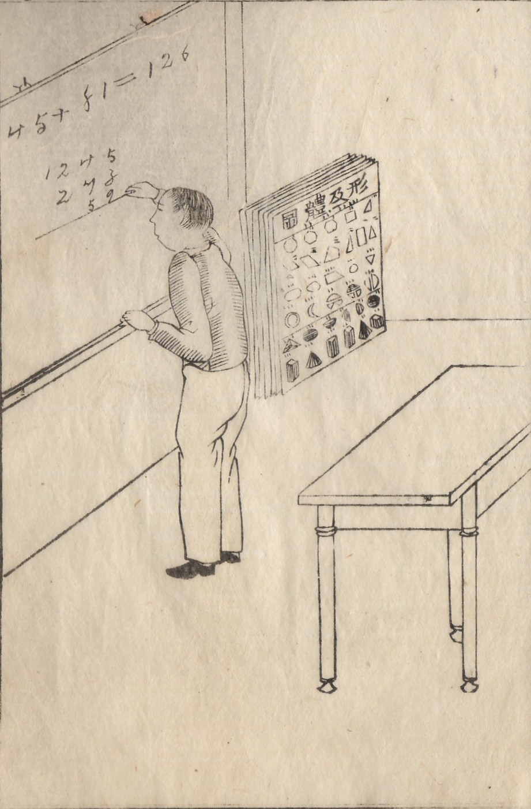

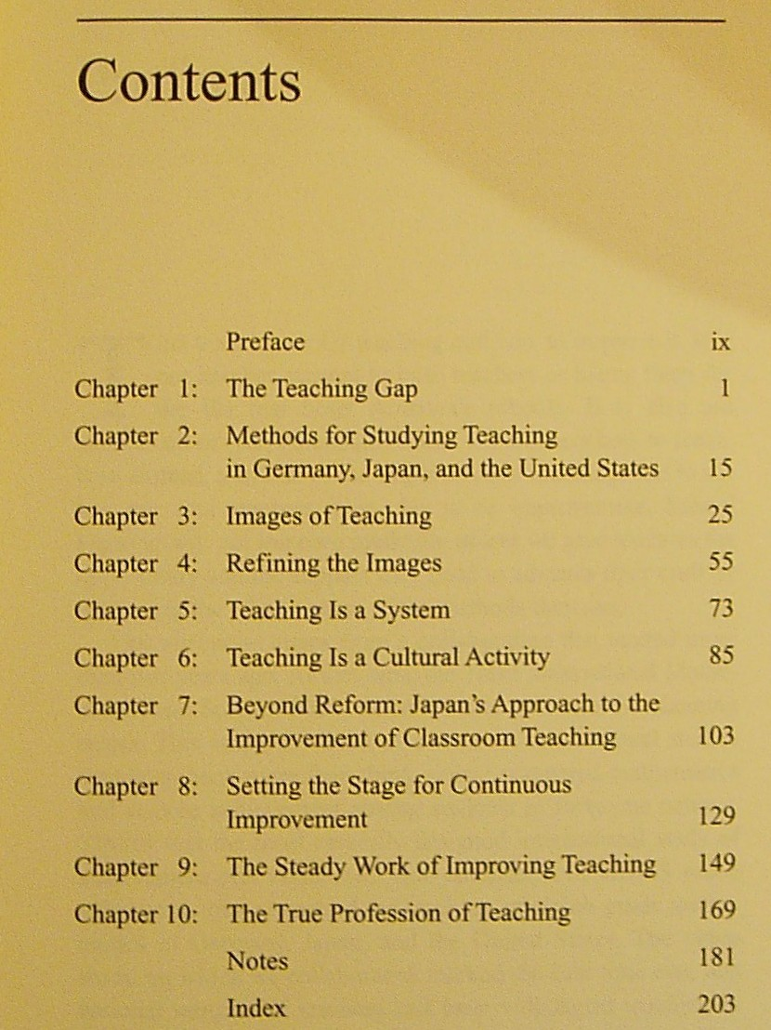
1.Overview: APEC Lesson Study Projects (LSPs)
At the end of 1990s, Scholars in USA established Japanese Style lesson study movement from USA and its influenced in World.
<Demands of Educational Ministers>
1st Stage: Establishment of LS Network
The year 2006 LSP: Search the various approaches and set the Japanese approach as for the methodology.
The year 2007 & 2008-9 LSPs: Focus on Mathematical Thinking and Communication.
The year 2009: Influenced to the English LSP by Chinese Taipei and so on.
2nd Stage: Shifted to produce Material
The year 2010 LSP: Assessment Tasks
The year 2011 LSP: e-Textbook
<Collaborate with other APEC fora>
<Emergency Preparedness Working Group>
3rd Stage: Emergency Preparedness Education including Science
The year 2010 LSP: Earthquake and Tsunami
The year 2011 LSP: Flood and Typhoon
The year 2011 LSP: Volcanic Eruption and Fire
141 Years ago, Japanese began lesson study (LS) for Pestalozzi methods which was imported from USA.

Slide 6
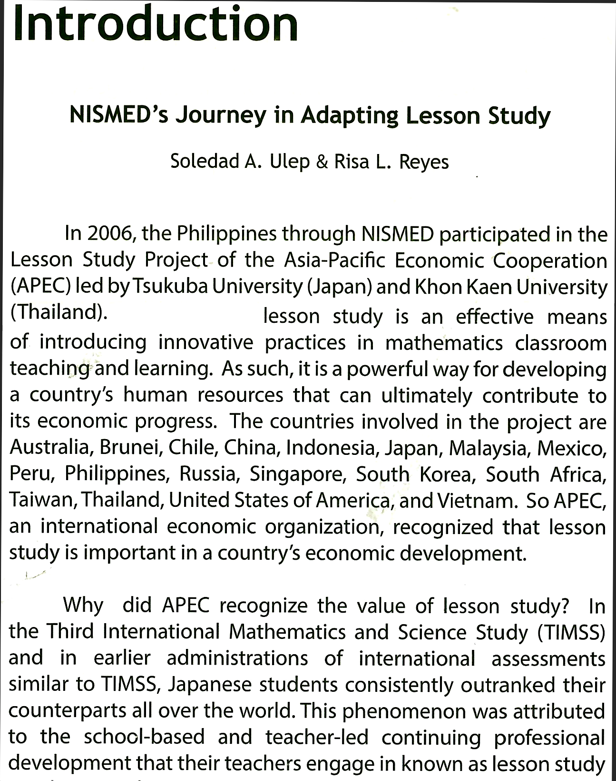
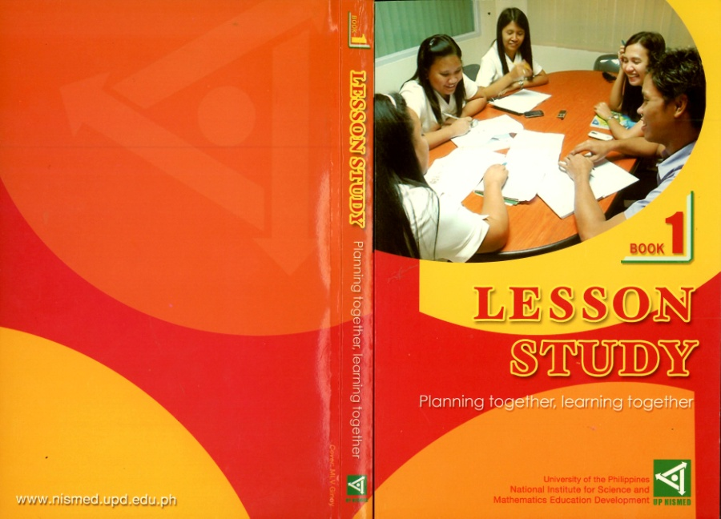
APEC Lesson Study movement written by Philippines
Newest Achievement in LSPs Network from the
University of Philippines
2013, Oct.
Chinese Taipei
Indonesia, Singapore and Brunei have been enhancing Lesson Study Nationally.

Slide 7
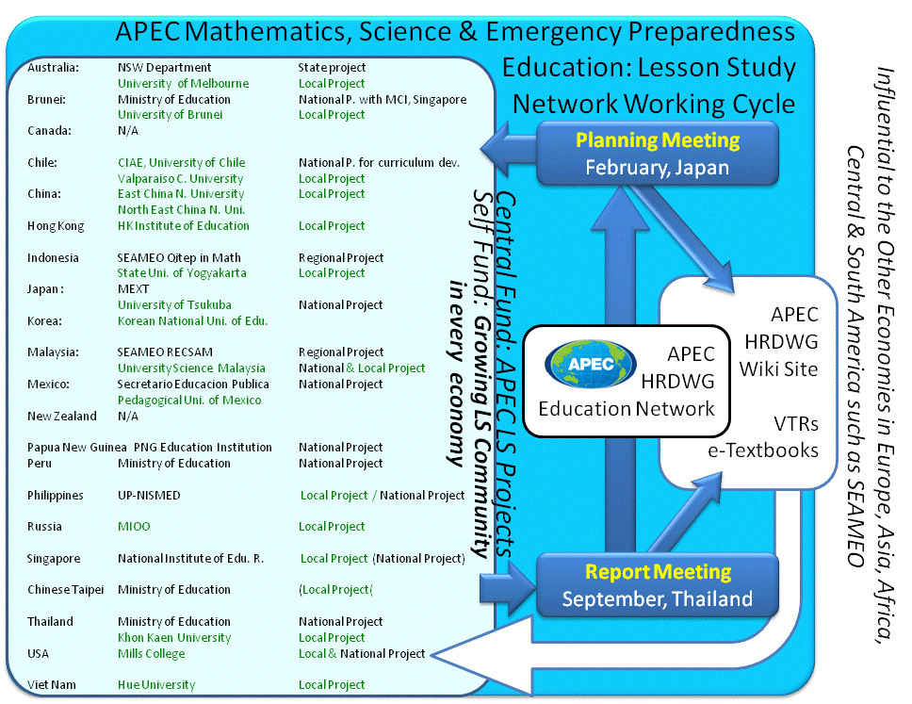
2. Involved Personnel and Organizations
LSPs estableished the LS community in APEC
19 economies:
11 Government Organizations
16 Major Teacher Education Institutes
We have been working together for our future and welfare under APEC HRDWG. Lead shepherds and EduNET coordinators have been supporting us, a lot.
Each economy has been making its efforts under APEC LSPs.
LSPs in each economy are done by its self fund for reporting their effort to the APEC LSPs. Each project in each economy is done by LS experts.

Slide 8
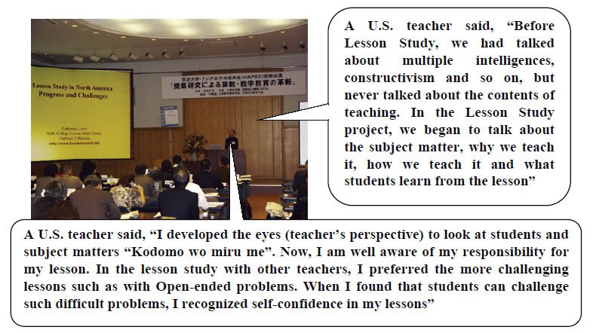
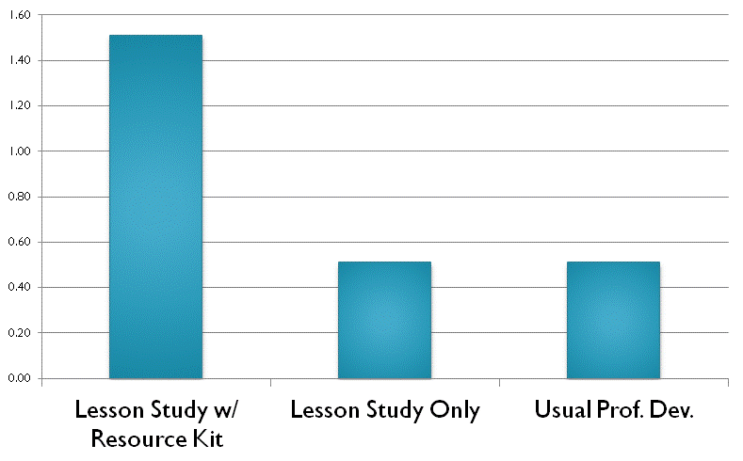
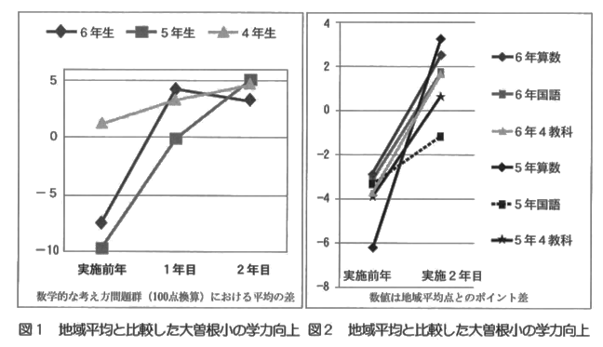
3. Methodology: Power of LS
Catherine Lewis (2006), USA
Teachers’ Professional
Development by
Catherine Lewis (2010)
USA
G.
G.
G.
G. Math
G. Japanese
G. M, J, S & Social S
G. Math
G. Japanese
In Thailand, a project school improved it’s achievement from 35 points to 81 points.
Maitree Inprasitha (2010)
G. M, J, S & Social S
Pre-Test 1st Y. 2nd Y.
Pre-Test 2nd Y.
Mathematical Thinking Improvement of Other Subjects
Improvement of Students By Masami Isoda (2010), JPN

Slide 9
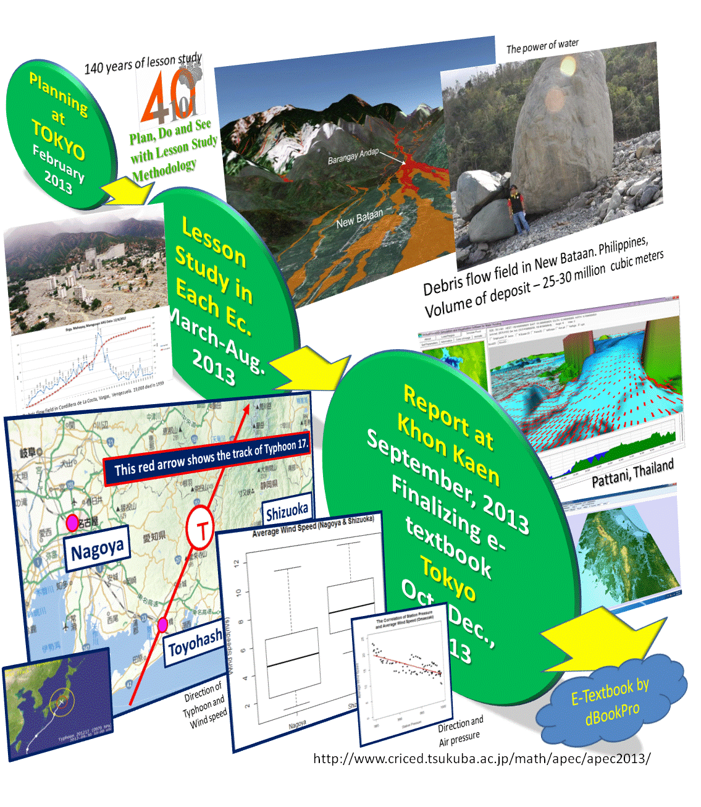
PDCA (plan-do-check-act): Yearly Cycle
Every year:
Planning at Tokyo by APEC fund
Lesson study is done by self fund in each economy
Reporting at Khon Kaen by APEC fund
Actions are done by teacher trainig institutions.
Why we were supported by self-fund?
If APEC project leads us, our government might support us because it is the our issue which has the priority. Mathematics is the major literacy subject. Emergency preparedness education and science are necessary.

Slide 10
4. Success Factors of LSPs.
The project selected the inevitable subjects: mathematics,
science, and emergency preparedness education.
Lesson Study Methodology is appropriate for themes and excellence.
Project are managed by a Matured Economy and a Raising Economy.
In Japan, we shared Models. Thailand shows possible solutions with in reach.
Then, any economy can!
Every specialist from economy has ownership under lesson study policies.
Every specialist well supported
by the self-fund from the
ministry or institution.
The products such as video and
e-textbooks produced by every
economy are visible and
distributed through the web.
We changed the knowledge flow from North-South mind to the mind which everyone can lead on the context of LS activity for our innovation. We established the policy that everyone says that it is our project!

Slide 11
Emergency Preparedness
Every economy knows the importance of Emergency Preparedness Education.
However, there is no teaching slot and teachers do not know what and how.

Slide 12
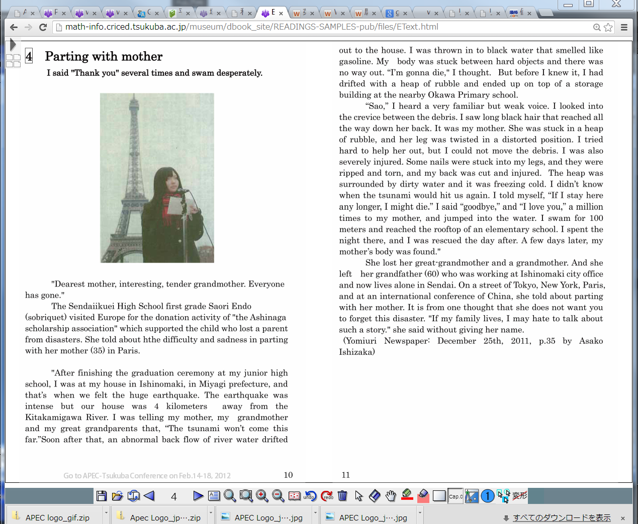
Produced e-Textbooks with collaborations
Available in Various languages such as Spanish, Indonesian, Thai, Korea and Japanese

Slide 13
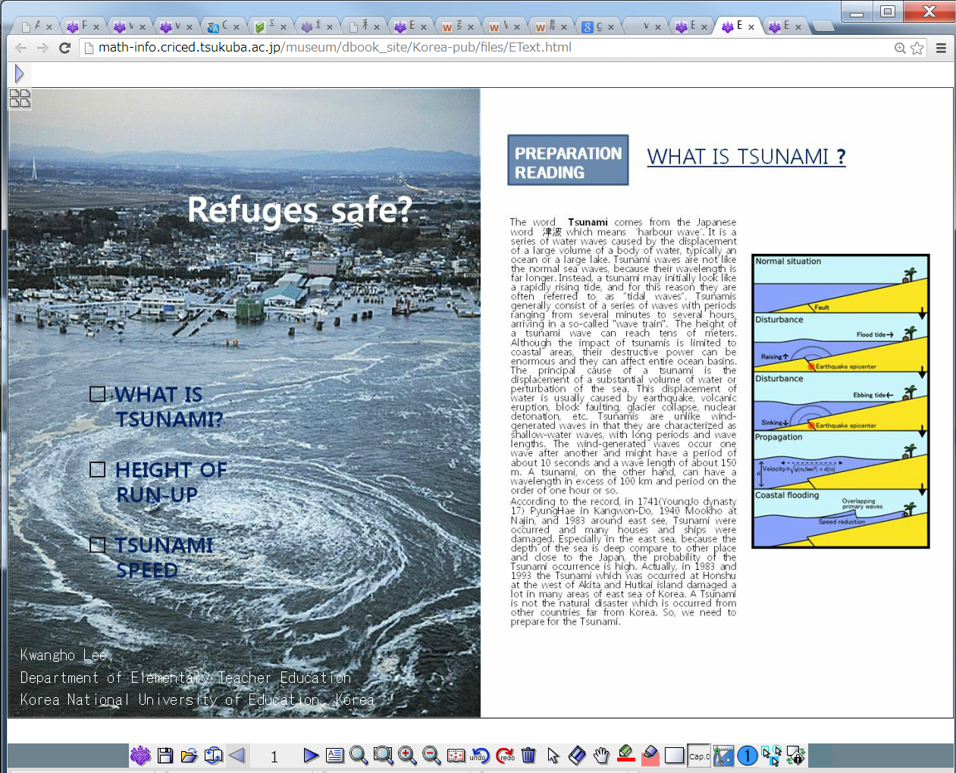
A Sample:
Tsunami textbook by Korea
Every participating economy produced such excellent textbooks.
Indonesia produced the e-textbook which has more than 100 pages.

Slide 14
5. Best Practices: Beyond the limitation of APEC grant
Best Practices are produced by the self-funds in economies
Our network is well functioning.
How?
I will show you some evidence.
19 economies produce products by their funds.

Slide 15
Best Practices: Beyond the limitation of APEC grant
Best Practices are produced by the self-funds in economies
Networking by the self-funds in economies in relation to APEC funds
  All collaboration of Lesson Study Network
  Collaboration between/among economies
  Best Practices in economies
Best Practices as the models for teachers' cultural activities who ensure the better quality of education in APEC economies
Best Practices as the model of multi-year projects in HRDWG
Best Practices for producing visible
and user-revisable content such as
Videos and e-Textbooks for sharing
in APEC economies: In relation to ICT
Education and APEC HRDWG wiki site.
Best Practices as for Mathematics,
Science and Emergency Preparedness
Education as for the Priority Areas on
HRDWG and APEC with bridging the
different APEC Fora

Slide 16
How influential?
Objective of our meetings are to produce materials.
We can participate if we produce materials.
Project is innovative and influential because it usually include new ideas for knowledge based S.

Slide 17
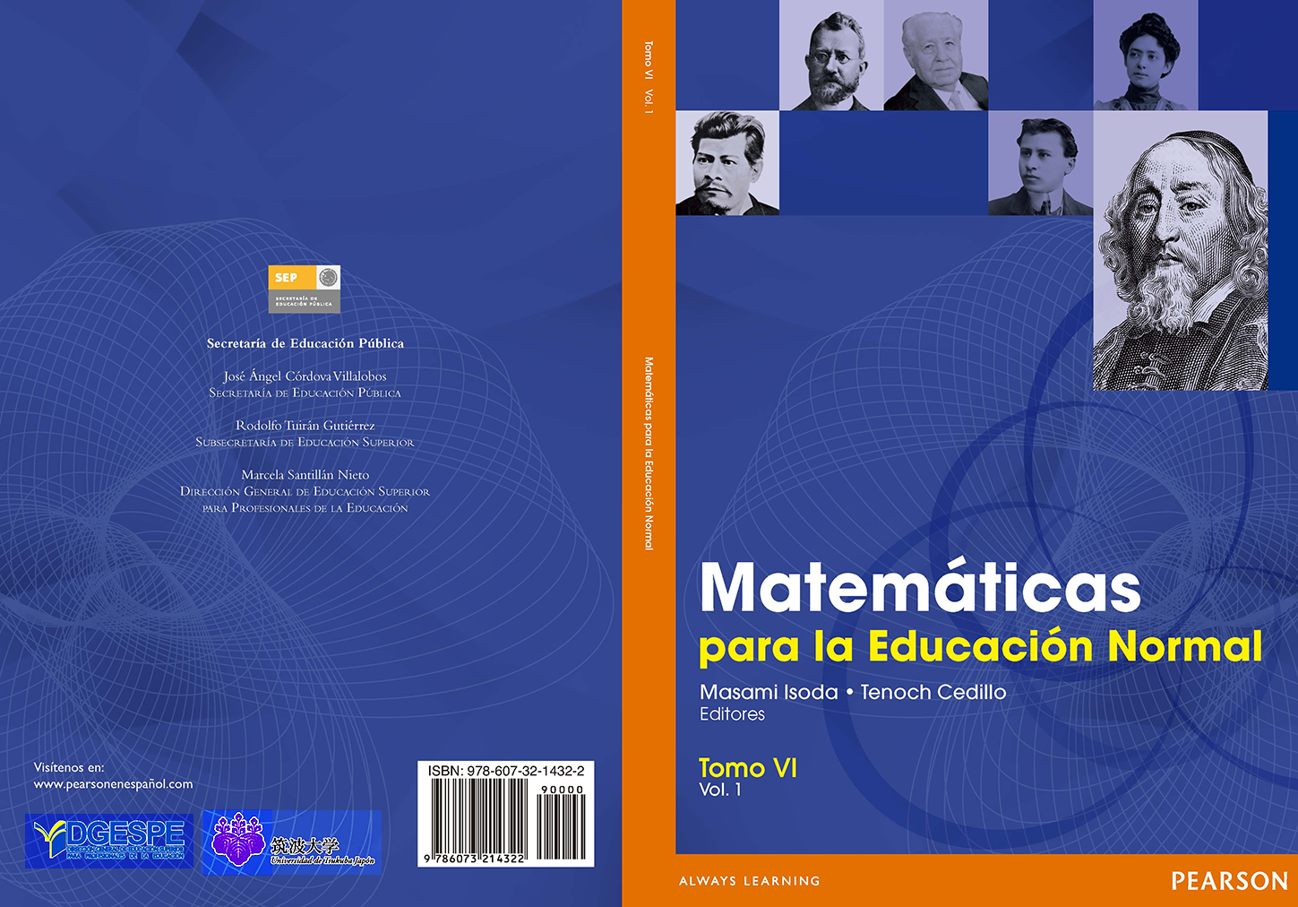
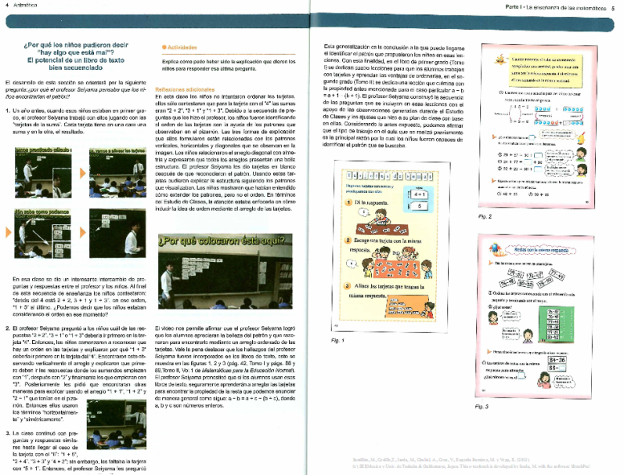
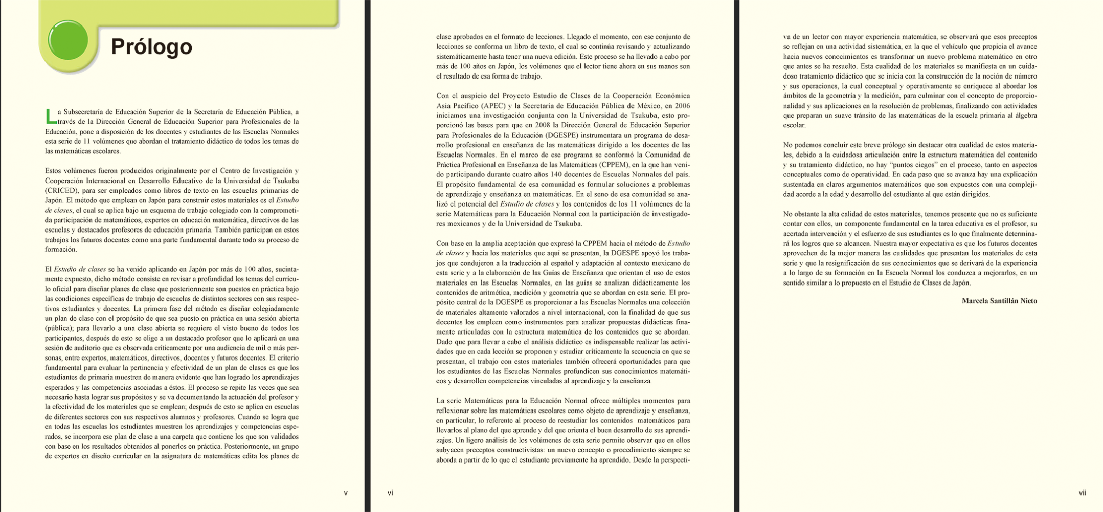
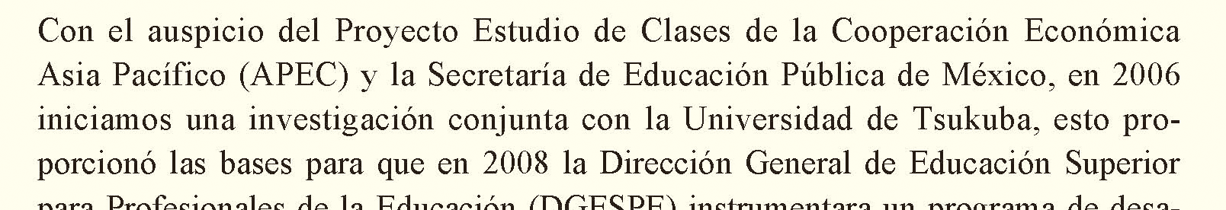
Mexico Published Teacher Education Textbooks (2012)
In 2006, Ministry of Education (Secretaria de Educacion Publica), Mexico, participated APEC Lesson Study Project and in 2008, began to collaborate with University of Tsukuba.
Total: 13 voles!!

Slide 18



Developing Sharable Content for LS in APEC
Well-known achievements in LSP-network:
Singapore Textbooks adapted to Brunei and Chile
Japanese Textbooks adapted to Thailand and Mexico
Australia developed source books from Japanese books.
Chile established LS guide books with Japanese.

Slide 19
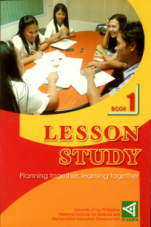
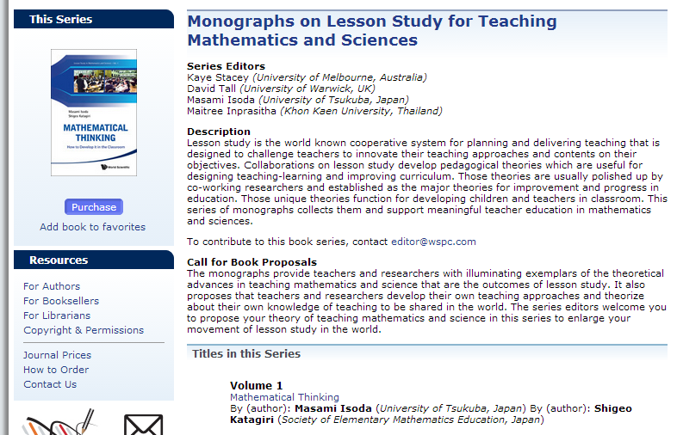
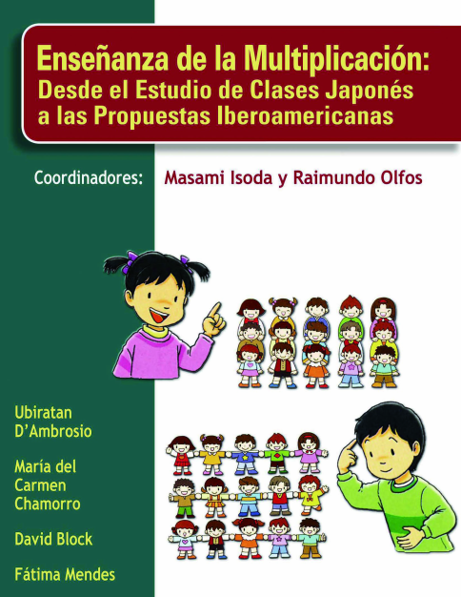
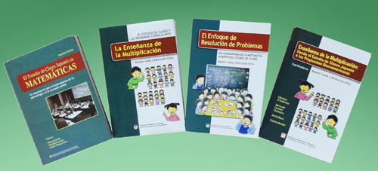
A Number of Lesson Study Guidebooks from APEC-Regional for the Worldwide use!
As well as OECD PISA books?!
Proposal from Latin America for Japanese Lesson Study
APEC Lesson Study Book Serious
Established the influence of APEC lesson study project to the world:
For example, the case of SEAMEO, SEAMEO Qitep in Math and SEAMEO RECSAM established Lesson Study course and developed Lesson Study guide books for teachers. Chelian books developed the book for Latin America.

Slide 20
6. Strengths and Weakness
Strengths
  Mathematics is universal language which necessary for Engineering, Technology and Science, and every economy needs it for the economical development.
  We established the system for working togerther! Lesson study network in Mathematics Education under HRDWG Education Network
  Producing free re-producible e-textbook on the web.
Weakness
  LSP Network is open for everyone
  however office working staffs and
  researchers have to change their
  mindsets to work likely as teachers
  depending on economies
  LSP Network is trying to produce
  the activity to integrate both top
  down and bottom up approaches
  for educational innovation however
  need the efforts for integration.

Slide 21
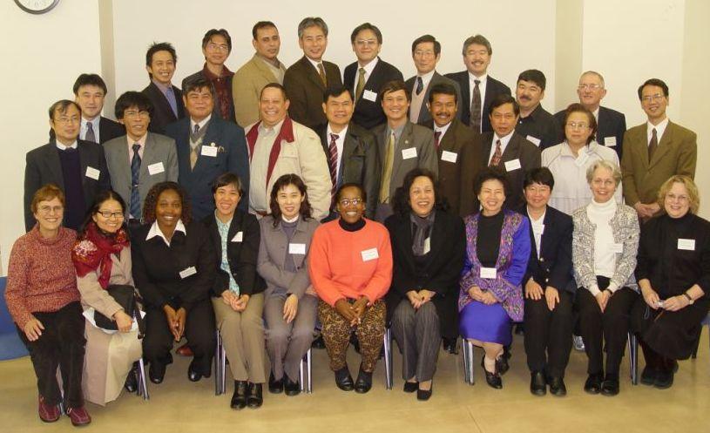
Reference http://www.criced.tsukuba.ac.jp/math/apec/ http://math-info.criced.tsukuba.ac.jp/museum/dbook_site/#e

Slide 22

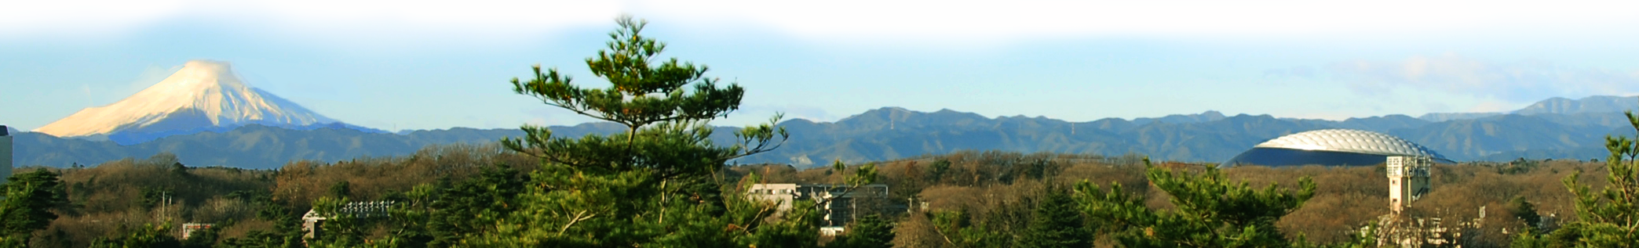
Acknowledgements
Project overseers of LSPs are Masami Isoda, PhD and Maitree Inprasitha, PhD.
LSPs are managed by the University of Tsukuba, Japan and Khon Kaen University, Thailand under the Ministry of Education, Culture, Sports, Science and Technology, Japan and Ministry of Education, Thailand.
We, project overseers and all specialist from economies, acknowledge to the cosponsoring, participating economies and APEC Secretariat for all of their support to the LSPs because our achievements are possible under their supports.

